Slide 1

Geometry
Unit 5, Lesson 2 Exploring Side-Angle-Side and Angle-Side-Angle Congruence Volume 1, pg. 229

Slide 2


Benchmarks
MA.912.GR.1.2
Prove triangle congruence or similarity using Side-Side-Side, Side-Angle-Side, Angle-Side-Angle, Angle-Angle-Side, Angle-Angle, and Hypotenuse-Leg.
MA.912.GR.5.1
Construct a copy of a segment or an angle.
volume 1, pg. 229

Slide 3
Integrated Mathematical Thinking and Reasoning Standards
MA.K12.MTR.1.1 Actively participate in effortful learning both individually and collectively.
MA.K12.MTR.4.1 Engage in discussions that reflect on the mathematical thinking of self and others.
volume 1, pg. 229

Slide 4

Learning Targets
I can use constructions to determine if SAS congruence can be used to show that two triangles are congruent.
I can use constructions to determine if ASA congruence can be used to show that two triangles are congruent.
I can use constructions to determine if SSA congruence can be used to show that two triangles are congruent.
volume 1, pg. 229

Slide 5

Warm-Up
volume 1, pg. 230

Slide 6
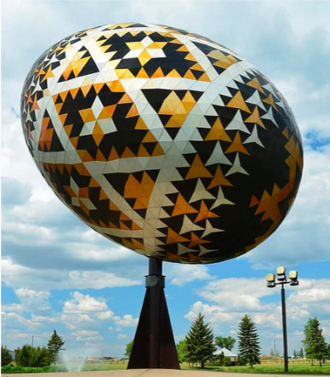
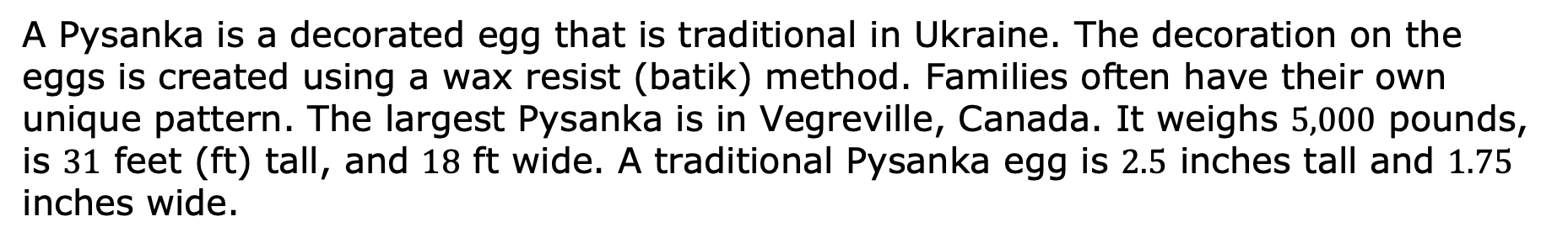
5.2.1 Warm-Up: Geometry in Art
A Pysanka is a decorated egg that is traditional in Ukraine. The decoration on the eggs is created using a wax resist (batik) method. Families often have their own unique pattern. The largest Pysanka is in Vegreville, Canada. It weighs $5,000$ pounds, is $31$ feet (ft) tall, and $18$ ft wide. A traditional Pysanka egg is $2.5$ inches tall and $1.75$ inches wide.
What do you notice about Pysanka eggs?
Estimate the number of traditional Pysanka eggs that will fit into the largest Pysanka. Show your work or explain how you found your estimate.
volume 1, pg. 230

Slide 7

Exploration
volume 1, pg. 230

Slide 8

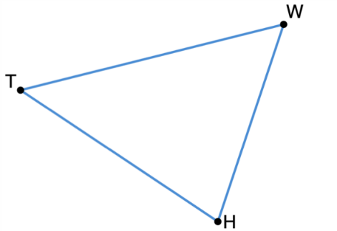
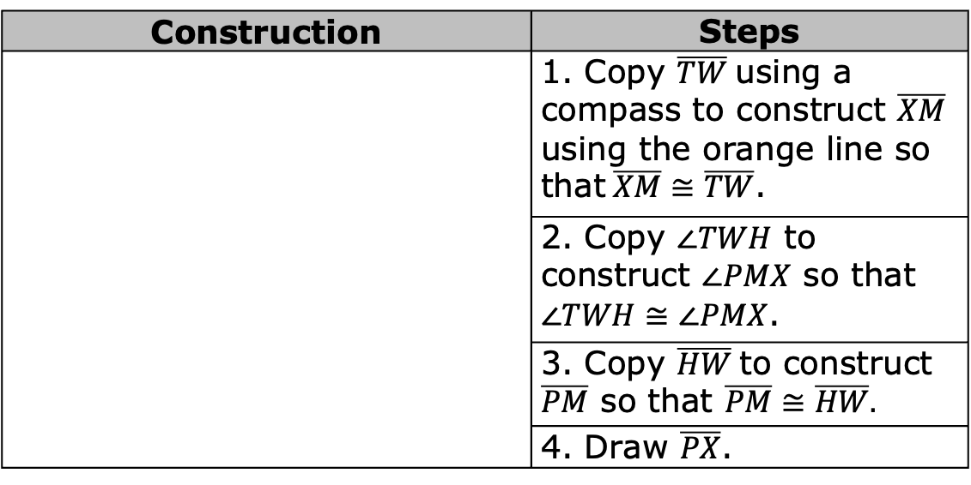
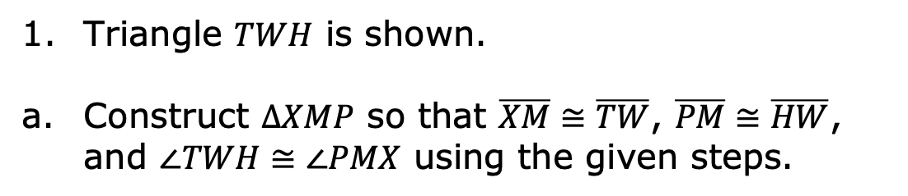
5.2.2 Exploration: Congruence Relationships
Triangle $TWH$ is shown.
Construct $∆XMP$ so that $\overline{XM}≅\overline{TW}$, $\overline{PM}≅\overline{HW}$, and $∠TWH≅∠PMX$ using the given steps.
Construction | Steps
 | 1. Copy $\overline{TW}$using a compass to construct $\overline{XM}$ using the orange line so that$\overline{XM}≅\overline{TW}$.
 | 2. Copy $∠TWH$ to construct $∠PMX$ so that $∠TWH≅∠PMX$.
 | 3. Copy $\overline{HW}$to construct $\overline{PM}$ so that $\overline{PM}≅\overline{HW}.$
 | 4. Draw $\overline{PX}$.
volume 1, pg. 230

Slide 9
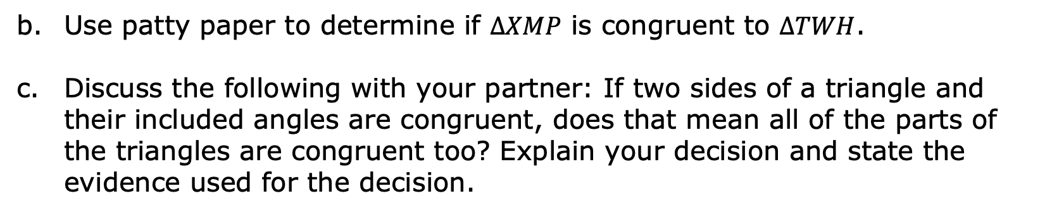
Use patty paper to determine if $∆XMP$ is congruent to $∆TWH$.
Discuss the following with your partner: If two sides of a triangle and their included angles are congruent, does that mean all of the parts of the triangles are congruent too? Explain your decision and state the evidence used for the decision.
volume 1, pg. 230

Slide 10
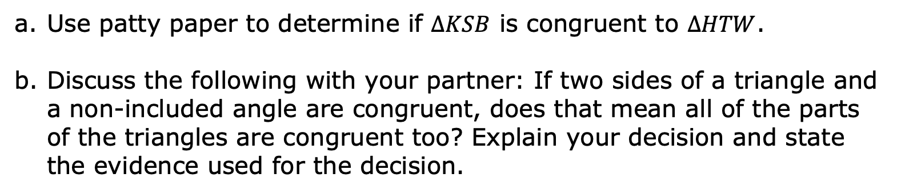
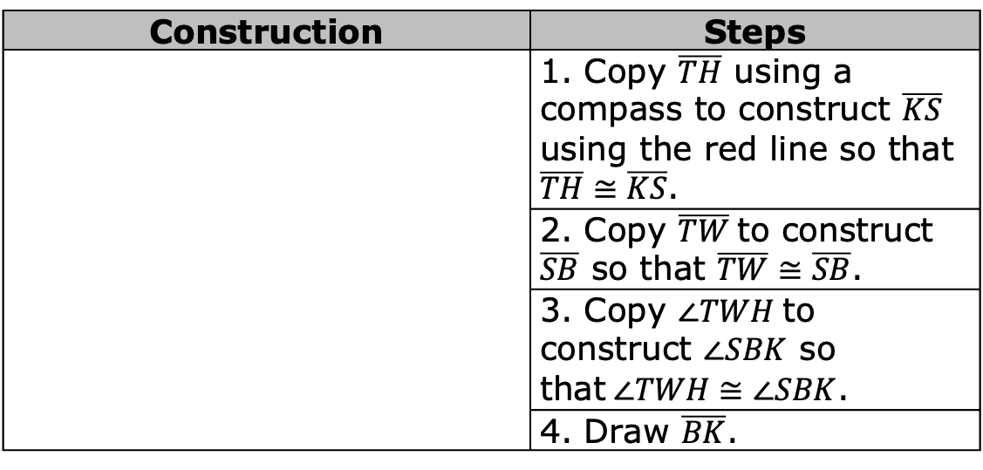
Construct $∆KSB$ so that $\overline{KS}≅\overline{TH}$, $\overline{SB}≅\overline{TW}$, and $∠TWH≅∠SBK$ using the given steps.
Construction | Steps
 | 1. Copy $\overline{TH}$ using a compass to construct $\overline{KS}$ using the red line so that $\overline{TH}≅\overline{KS}$.
 | 2. Copy $\overline{TW}$to construct $\overline{SB}$ so that $\overline{TW}≅\overline{SB}$.
 | 3. Copy $∠TWH$to construct $∠SBK$ so that$∠TWH≅∠SBK$.
 | 4. Draw $\overline{BK}$.
Use patty paper to determine if $∆KSB$ is congruent to $∆HTW$.
Discuss the following with your partner: If two sides of a triangle and a non-included angle are congruent, does that mean all of the parts of the triangles are congruent too? Explain your decision and state the evidence used for the decision.
volume 1, pg. 231

Slide 11
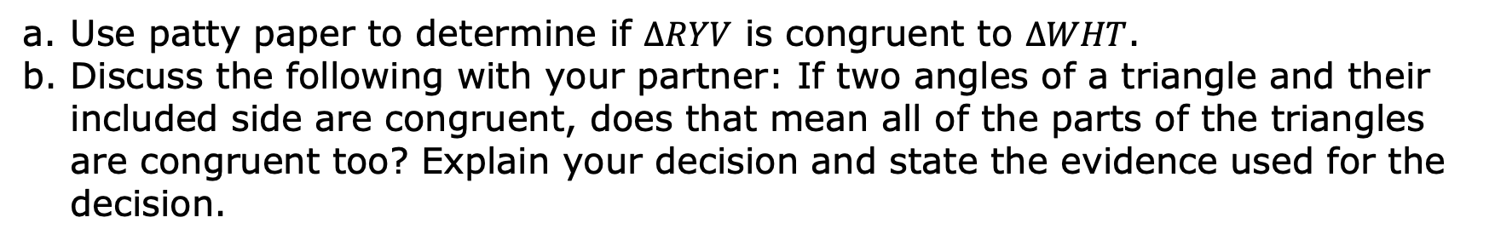
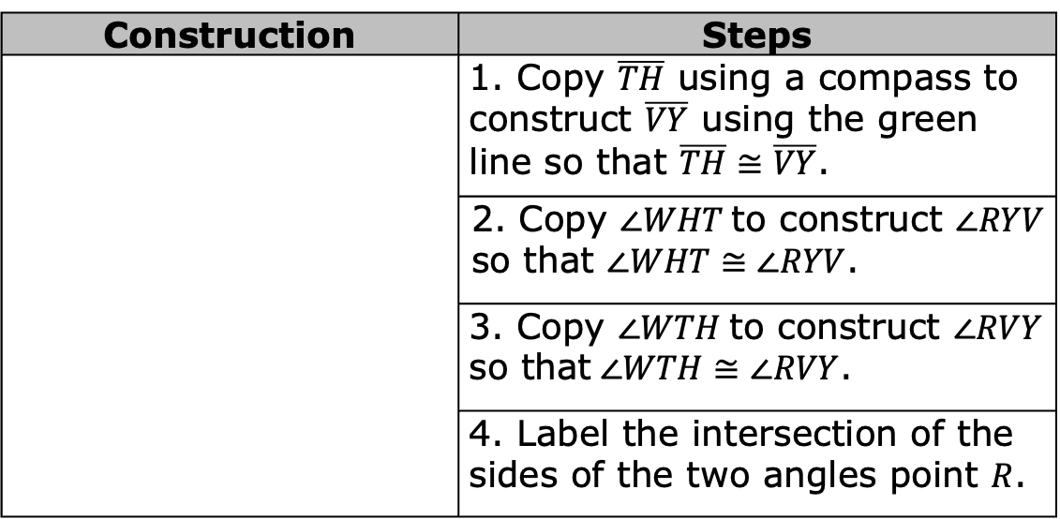
Construct $∆RYV$ so that $\overline{VY}≅\overline{TH}$, $∠WTH≅∠RVY$, and $∠WHT≅∠RYV$ using the given steps.
Construction | Steps
 | 1. Copy $\overline{TH}$ using a compass to construct $\overline{VY}$ using the green line so that $\overline{TH}≅\overline{VY}$.
 | 2. Copy $∠WHT$to construct $∠RYV$ so that $∠WHT≅∠RYV$.
 | 3. Copy $∠WTH$to construct $∠RVY$ so that$∠WTH≅∠RVY$.
 | 4. Label the intersection of the sides of the two angles point $R$.
Use patty paper to determine if $∆RYV$ is congruent to $∆WHT$.
Discuss the following with your partner: If two angles of a triangle and their included side are congruent, does that mean all of the parts of the triangles are congruent too? Explain your decision and state the evidence used for the decision.
volume 1, pg. 231

Slide 12

Bring It Together
volume 1, pg. 232

Slide 13

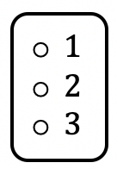
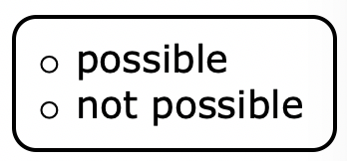
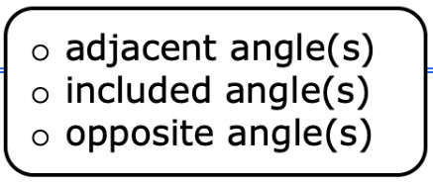
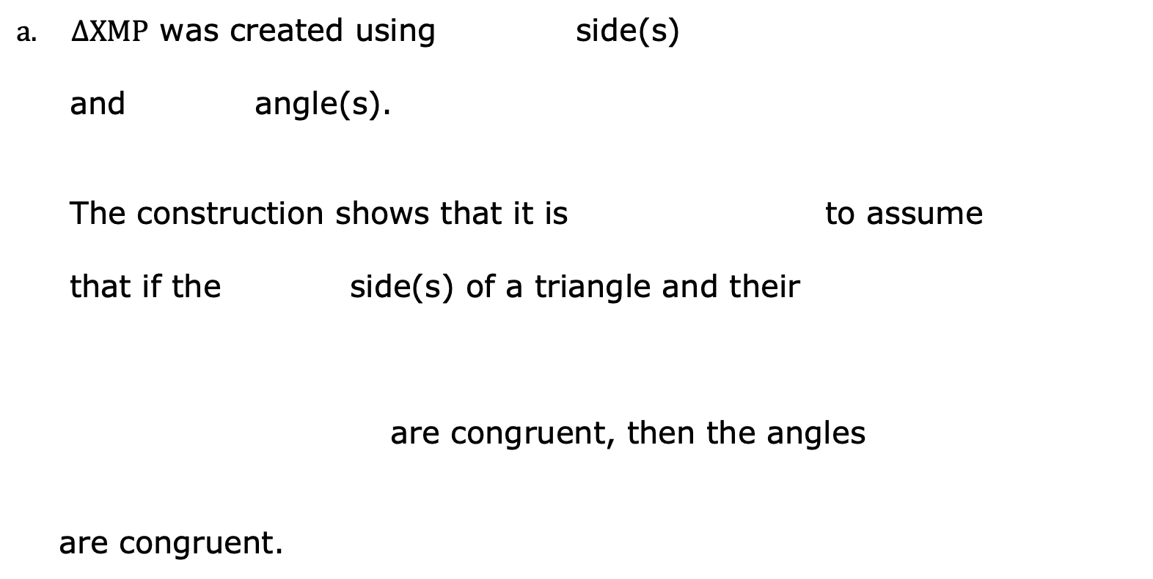
5.2.3 Bring It Together: Triangle Congruence
Complete the statements.
$∆XMP$ was created using side(s)
and angle(s).
The construction shows that it is to assume
that if the side(s) of a triangle and their
are congruent, then the angles
are congruent.
volume 1, pg. 232

Slide 14
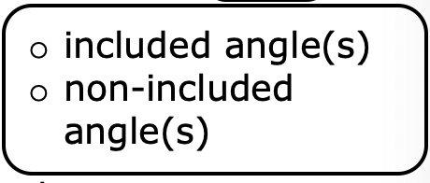
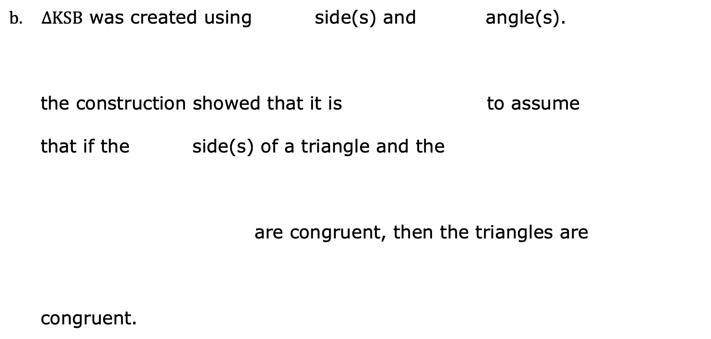
$∆KSB$ was created using side(s) and angle(s).
the construction showed that it is to assume
that if the side(s) of a triangle and the
are congruent, then the triangles are
congruent.
volume 1, pg. 232

Slide 15

$∆RYV$ was created using side(s) and angle(s).
The construction showed that it is to
assume that is the sides(s) of a triangle
and its are congruent, then the
triangles are congruent.
volume 1, pg. 232

Slide 16

Side-Angle-Side (SAS) Congruence Postulate
If two sides and the included angle of one triangle are congruent to two sides and the included angle of a second triangle, respectively, then the two triangles are congruent.
Side-Angle-Side (SAS) Congruence Postulate
If two sides and the included angle of one triangle are congruent to two sides and the included angle of a second triangle, respectively, then the two triangles are congruent.
volume 1, pg. 232

Slide 17
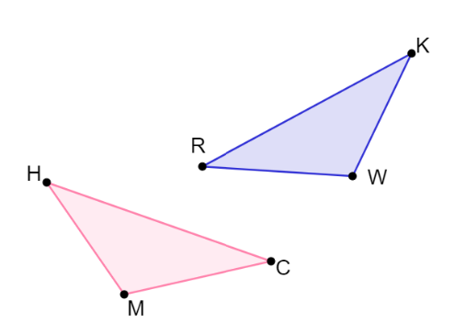
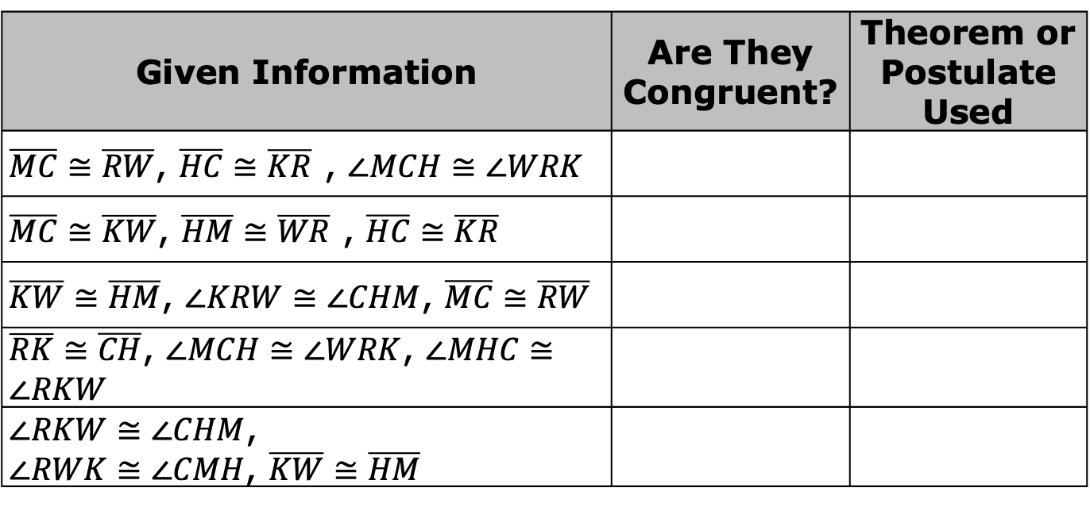
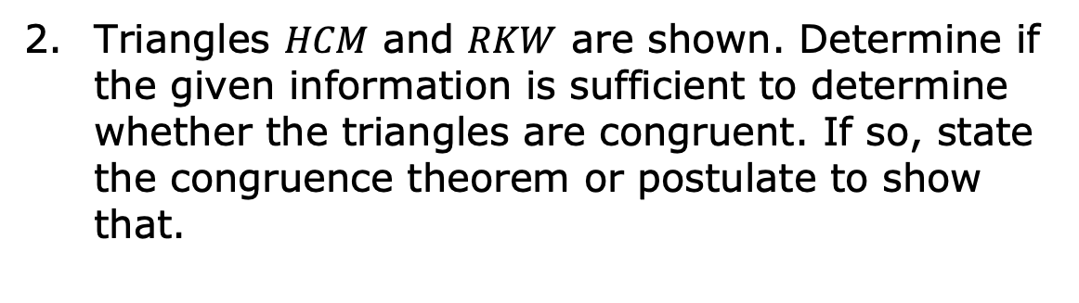
Triangles $HCM$ and $RKW$ are shown. Determine if the given information is sufficient to determine whether the triangles are congruent. If so, state the congruence theorem or postulate to show that.
Given Information | Are They Congruent? | Theorem or Postulate Used
$\overline{MC}≅\overline{RW}$, $\overline{HC}≅\overline{KR}$ , $∠MCH≅∠WRK$
$\overline{MC}≅\overline{KW}$, $\overline{HM}≅\overline{WR}$ , $\overline{HC}≅\overline{KR}$
$\overline{KW}≅\overline{HM}$, $∠KRW≅∠CHM$, $\overline{MC}≅\overline{RW}$
$\overline{RK}≅\overline{CH}$, $∠MCH≅∠WRK$, $∠MHC≅∠RKW$
$∠RKW≅∠CHM$, $∠RWK≅∠CMH$, $\overline{KW}≅\overline{HM}$
volume 1, pg. 233

Slide 18

Wrap-Up
volume 1, pg. 233

Slide 19
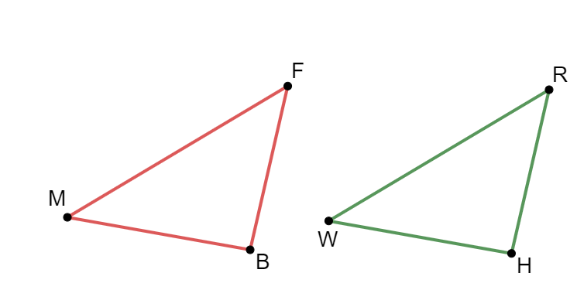
5.2.4 Wrap-Up: Ticket Out the Door
Triangles $BFM$ and $WRH$ are shown.
volume 1, pg. 233

Slide 20
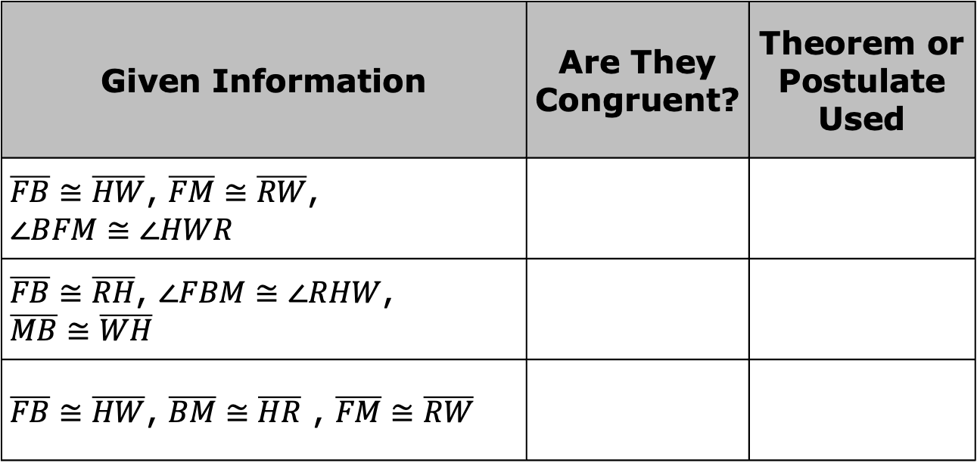
Determine if the given information is sufficient to determine that the triangles are congruent. If so, state the congruence theorem or postulate to show that.
Given Information | Are They Congruent? | Theorem or Postulate Used
$\overline{FB}≅\overline{HW}$, $\overline{FM}≅\overline{RW}$, $$∠BFM≅∠HWR$$
$\overline{FB}≅\overline{RH}$, $∠FBM≅∠RHW$, $$\overline{MB}≅\overline{WH}$$
$\overline{FB}≅\overline{HW}$, $\overline{BM}≅\overline{HR}$ , $\overline{FM}≅\overline{RW}$
volume 1, pg. 233

